Slide 1
Phone Reader 2.0
By: Hadley Scholtz
Supervisor: Mehrdad Ghaziasgar
Co - supervisor: James Connan
Mentor: Ibraheem Frieslaar

Slide 2
Overview
Quick Recap
System changes
High Level Design
Low Level Design Updates
User Interface Specification Updates
Project Plan
References
Demo

Slide 3
Quick Recap
Problem
Text in foreign languages are not understood
Users with impaired vision
Users that are illiterate.
Previous Solution
Phone Reader
Excellent novel idea.
Proposed Solution
Application with which users can take pictures, make selections and have selections read on their command.

Slide 4
System updates
Modified user interface
Added additional image processing algorithms
Implemented translation engine

Slide 5
High Level Design
Take Picture or opening an existing one
Make Selections
Send to server
Optical Character Recognition and Translation
Image pre-processing
Source image and coordinates
Send extracted text to device
Text-to-speech
Audio playback or text display

Slide 6
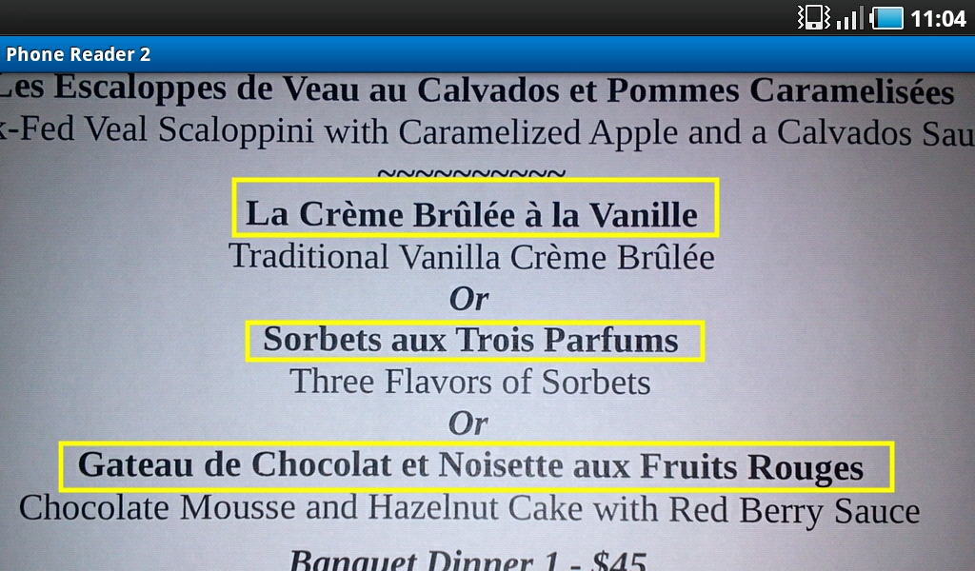
Low Level Design Updates
Image Segmentation:
Segment 1
Segment 2
Segment 3

Slide 7
Low Level Design Updates
Image Thresholding:
Adaptive thresholding to remove backgrounds

Slide 8
Low Level Design Updates
Image up-sampling:
Laplacian Pyramid to up-sample the image

Slide 9
User Interface Specification Updates
Overview of UIS
Take picture or open existing one
Select text segments
Cancel Selections (if desired)
Save and send coordinates to server
Tap selection to listen to audio or display translated text

Slide 10
User Interface Specification Updates
The splash screen

Slide 11
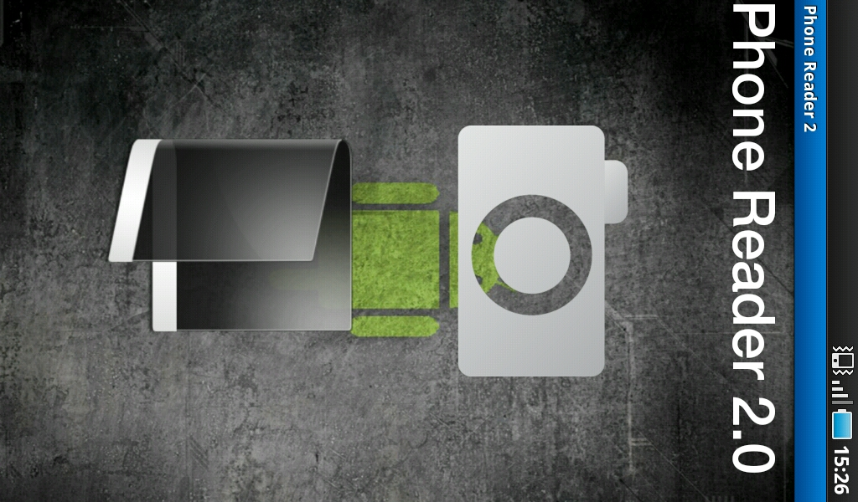
User Interface Specification Updates
The home screen

Slide 12
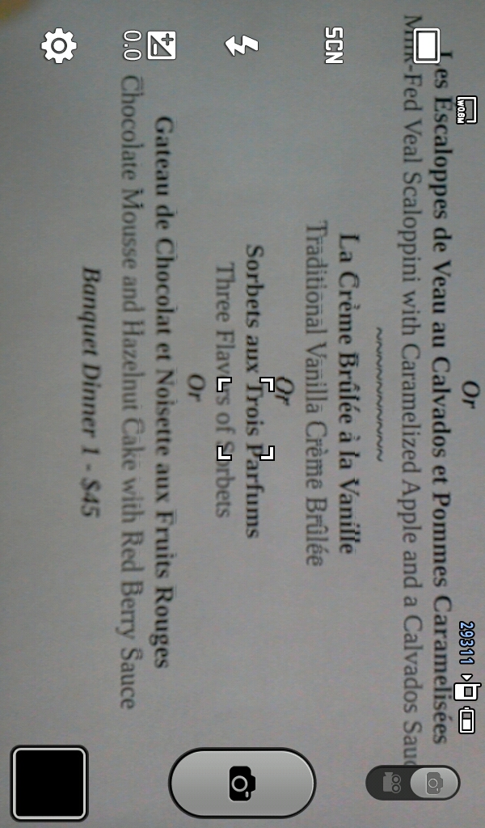
User Interface Specification Updates
The viewfinder

Slide 13
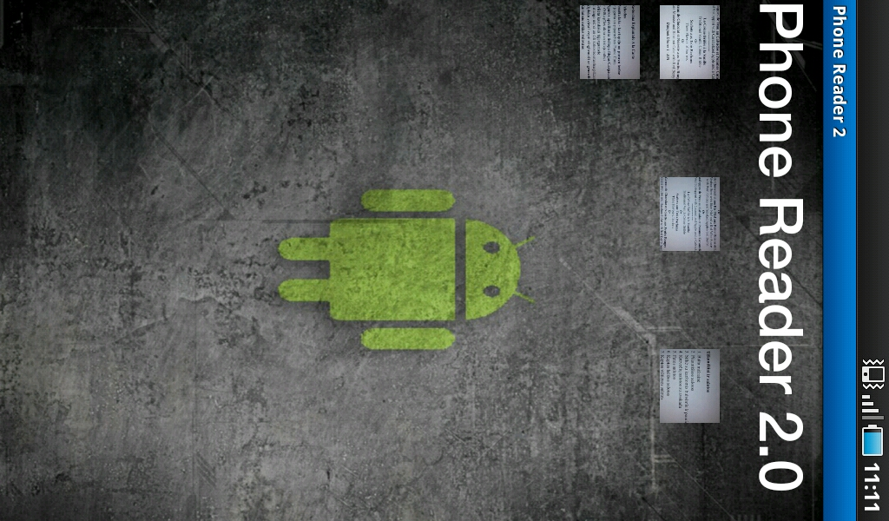
User Interface Specification Updates
The gallery

Slide 14
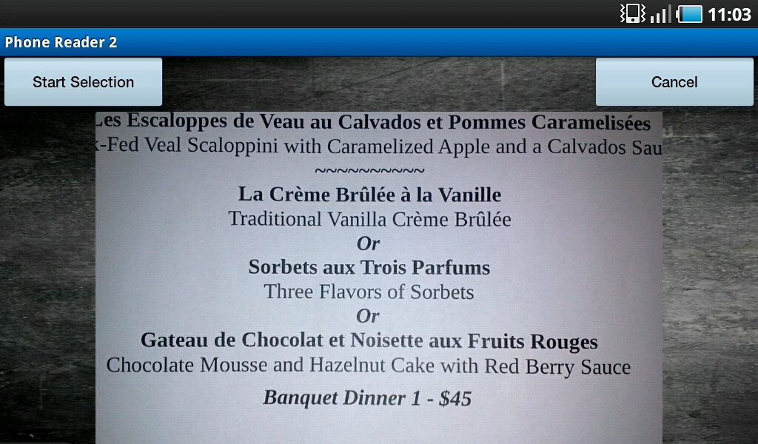
User Interface Specification Updates
The selection confirmation screen

Slide 15
User Interface Specification Updates
The selection screen

Slide 16
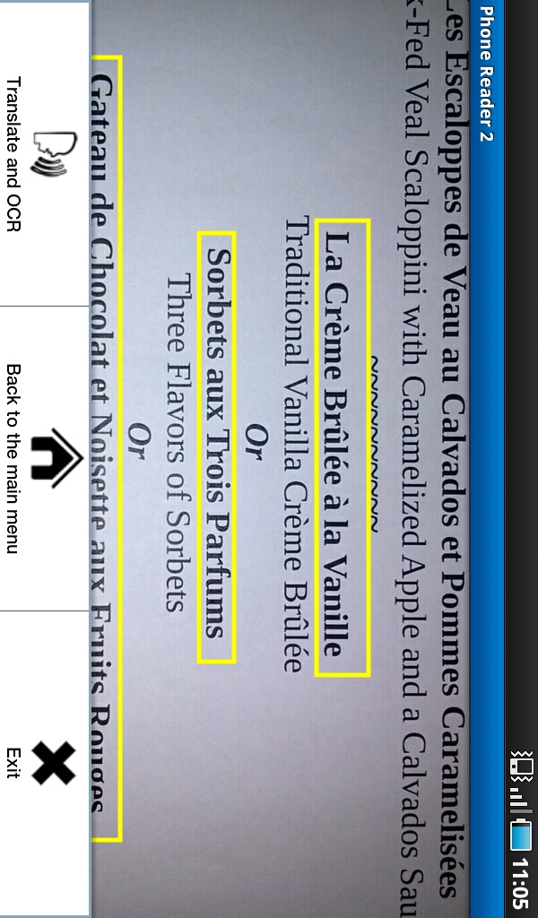
User Interface Specification Updates
The menu screen

Slide 17
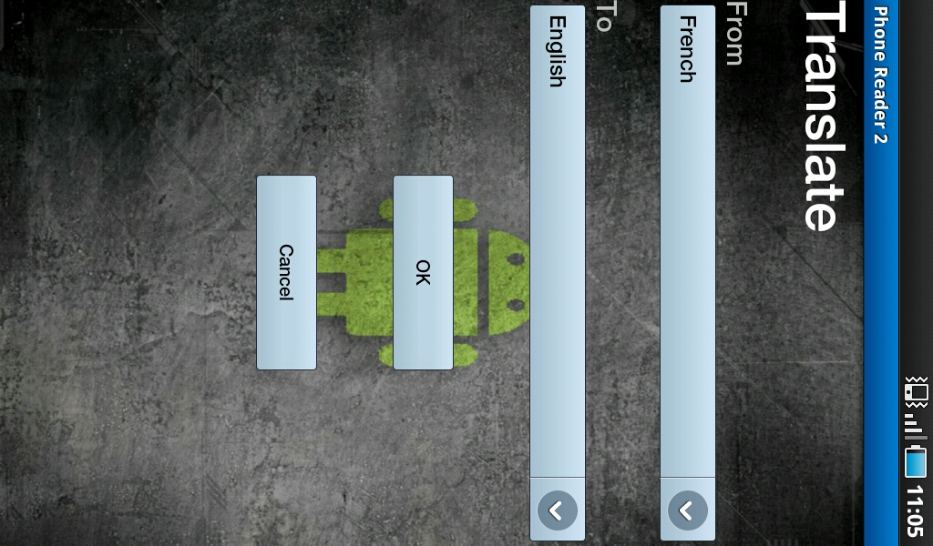
User Interface Specification Updates
The language selection screen

Slide 18
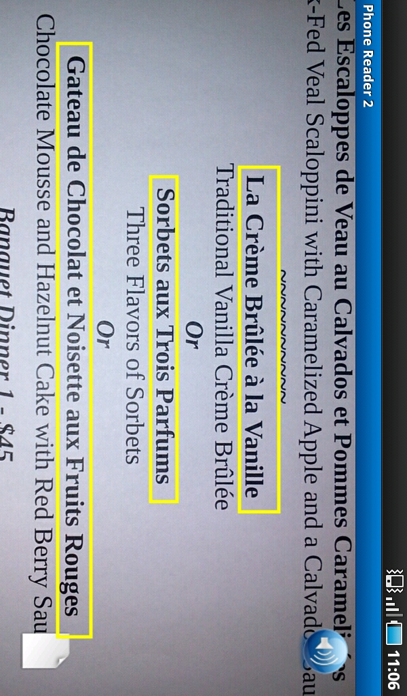
User Interface Specification Updates
The tts screen

Slide 19
Project Plan
Plan | Plan completion
Learn to use openCV tools to manipulate images. Research efficient image pre-processing techniques. Construct requirements document. | End of term 1
Design the proposed solution Develop a prototype of the proposed solution. | End of term 2
Improve prototype by adding additional features. | End of term 3
Test and deploy proposed solution. | End of term 4

Slide 20
References
Bradsky, G., & Kaehler, A. (2008). Learning OpenCV Computer Vision with the OpenCV Library. California: O'Reilly Media Inc.
Morris, J. (2011). Android User Interface Development. Birmingham: Packt Publishing Ltd.
Felker, D., & Dobbs, J. (2011). Android Application Development FOR DUMMIES. New Jersey: Wiley Publishing Inc.

Slide 21
Demo
Overview:
Taking a picture
Making Selections
OCR and Translate
Play audio and display text

Slide 22
Questions and answers

